Slide 1
English Graduate Session
Mary Claire Vandenburg
Tuesday, October 27th 2009
mcv@queensu.ca
Notes:
mcv@queensu.ca – feel free to email with questions, or requests for purchase (book rather than journals)

Slide 2
Points of Interest
Catalogue http://islander.library.queensu.ca/
e.g. tracking the new book shelf
Subject Guide http://library.queensu.ca/research/subjects
MLA and use guide, best reference
Database http://library.queensu.ca/research/databases
E-journals http://library.queensu.ca/research/ejournals/
Theses http://library.queensu.ca/research/format/finding-theses
Other catalogues
Amicus http://www.collectionscanada.gc.ca/amicus/index-e.html
Worldcat http://www.worldcat.org/
CRL http://www.crl.edu/
Notes:
And anything else that you would like to cover…

Slide 3
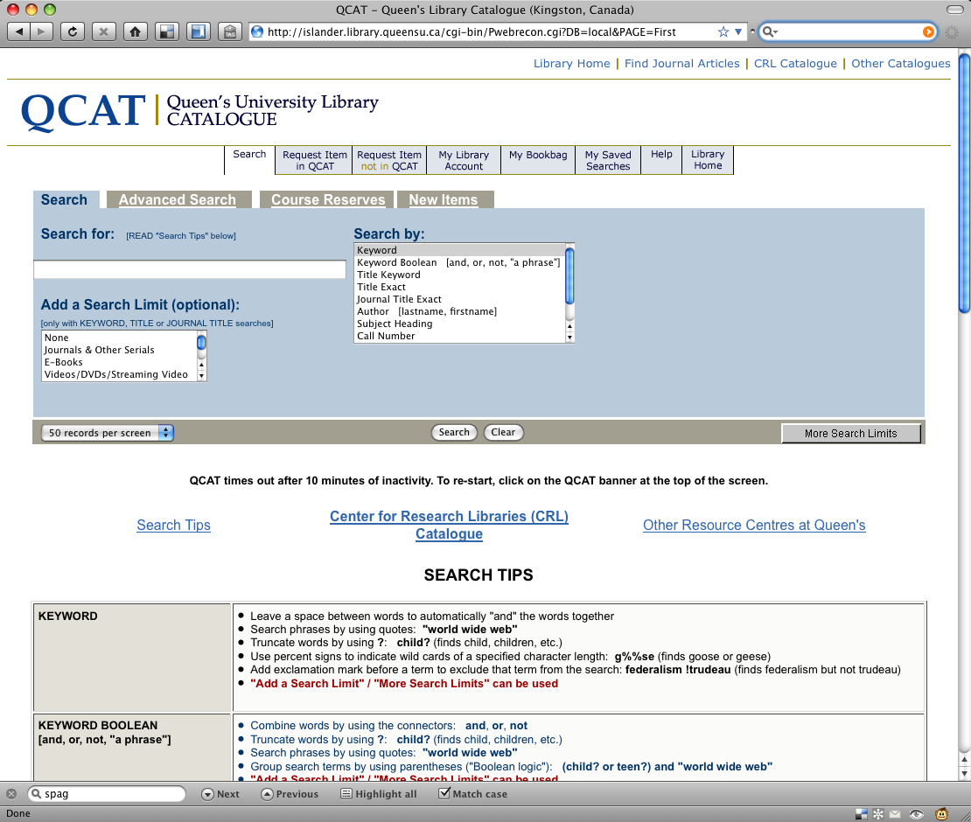
New Book Search http://islander.library.queensu.ca

Slide 4
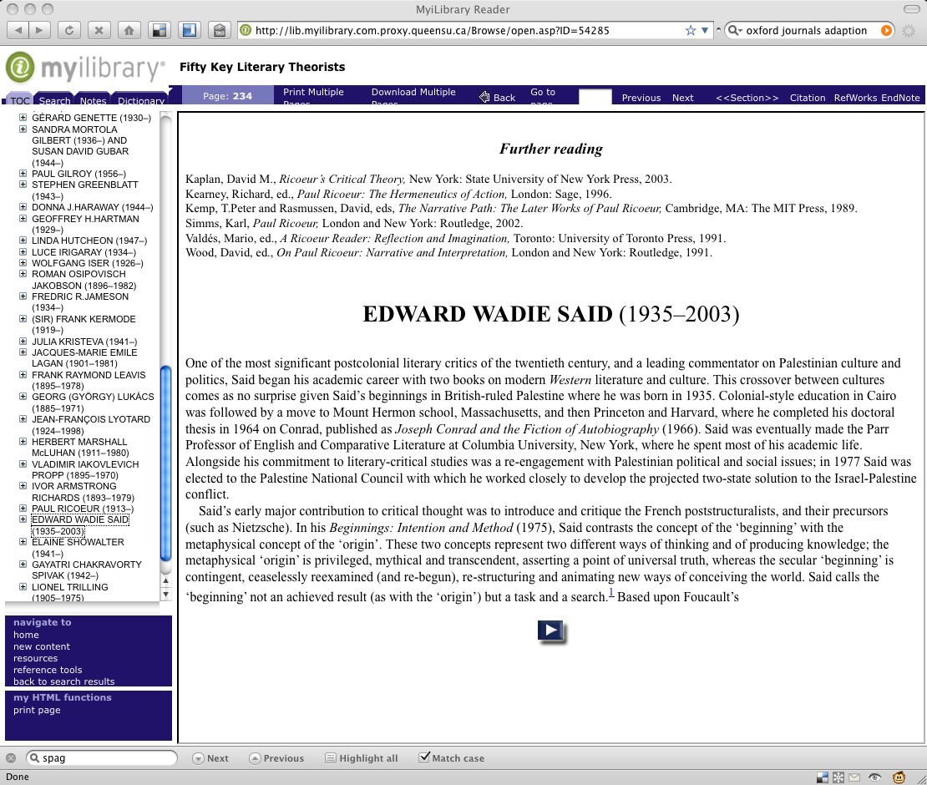
E-books http://library.queensu.ca.proxy.queensu.ca/research/ebooks/

Slide 5
Cited Reference Searching http://library.queensu.ca/inforef/citation.htm
Allows you to trace the evolution of an idea from one authors paper backward using its bibliography and forward using cited reference searching
Notes:
Eg.:

Slide 6
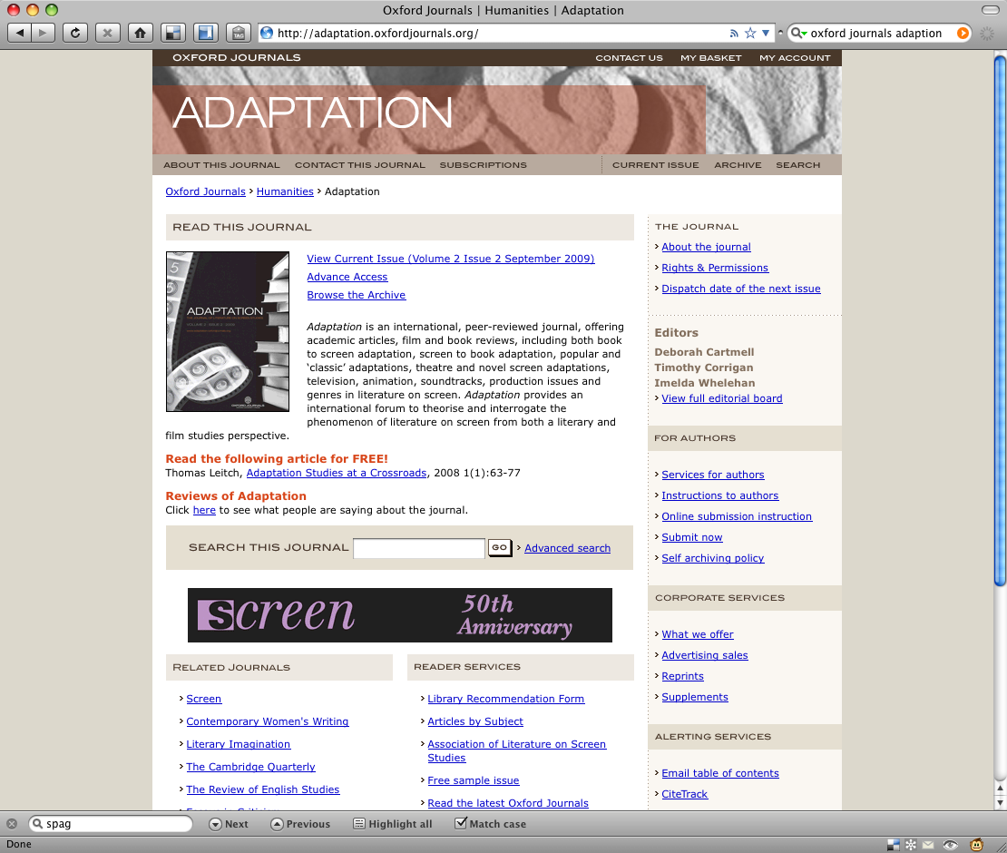
E-journal Websites http://adaptation.oxfordjournals.org/
Sign up for TOC

Slide 7
Possible Course-Collection Mappings
Remembering Slavery: History, Memory, and the Caribbean Diasporic Novel
Slavery, Abolition and Social Justice, 1490-2007
http://proxy.queensu.ca/login?url=http://www.slavery.amdigital.co.uk/
Sexuality and Victorian Literature
Defining Gender, 1450-1910
http://proxy.queensu.ca/login?url=http://www.gender.amdigital.co.uk/
Medieval Travel and Ethnographic Writing
Medieval Travel Writing
http://www.medievaltravel.amdigital.co.uk/index.aspx
Indigenous Governance through Indigenous Literature
Subject Guide>Article Indexes>Aboriginal Studies
http://library.queensu.ca/research/guide/aboriginal-studies
Notes:
Slavery, Abolition & Social Justice:
Defining Gender:
Chronology: Prostitution in London With a Comparative View of that of Paris and New York
Or Documents:
Medieval Travel Writing:
Aboriginal Studies:
Note indexes, Canadian, Windspeak

Slide 8
Primary Sources
Primary Sources in the Humanities and Social Sciences:
Subject Guide
http://library.queensu.ca/research/guide/primary-sources/websites
British and Irish Women's Letters and Diaries
http://solomon.bwld.alexanderstreet.com.proxy.queensu.ca/index.html
Early English Books Online
http://eebo.chadwyck.com.proxy.queensu.ca/home
Eighteenth Century Collections Online
http://galenet.galegroup.com.proxy.queensu.ca/servlet/ECCO?locID=queensulaw
Journal / Newspaper Indexes
House of Commons Parliamentary Papers (U.K.)
http://proxy.queensu.ca/login?url=http://parlipapers.chadwyck.com/
Globe and Mail / Toronto Star
London Times New York Times

Slide 9
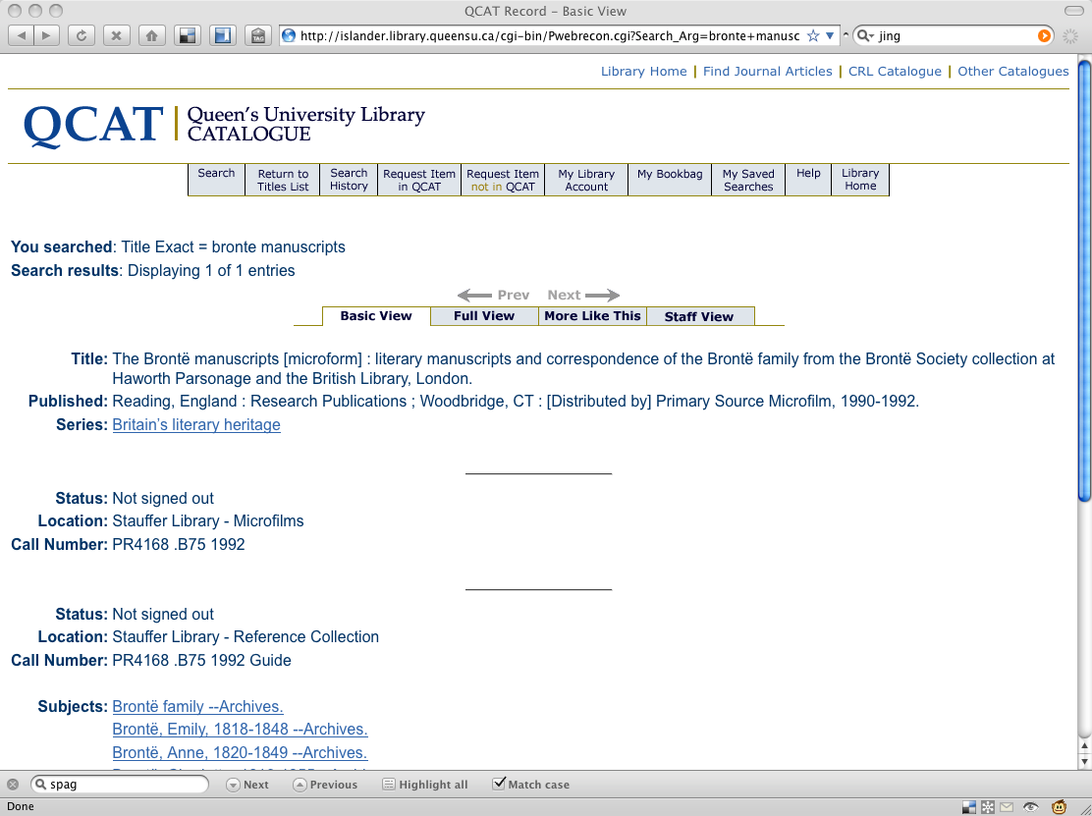
basement of Stauffer
Note: guide in Reference Collection (1st floor)

Slide 10
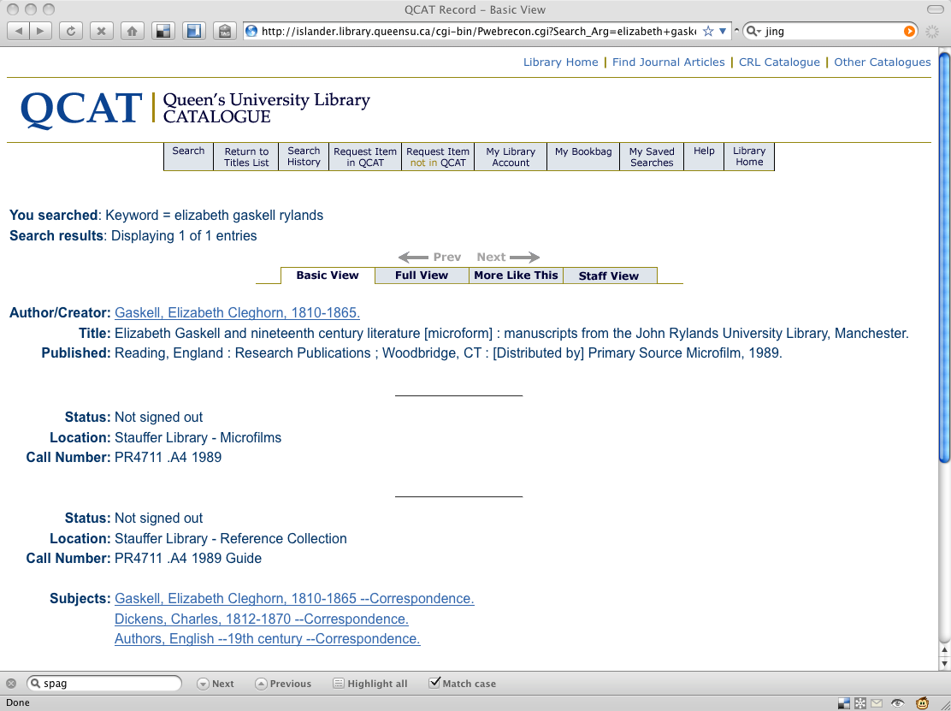
Now referred to as Her Own Words: The E. Gaskell Collection

Slide 11
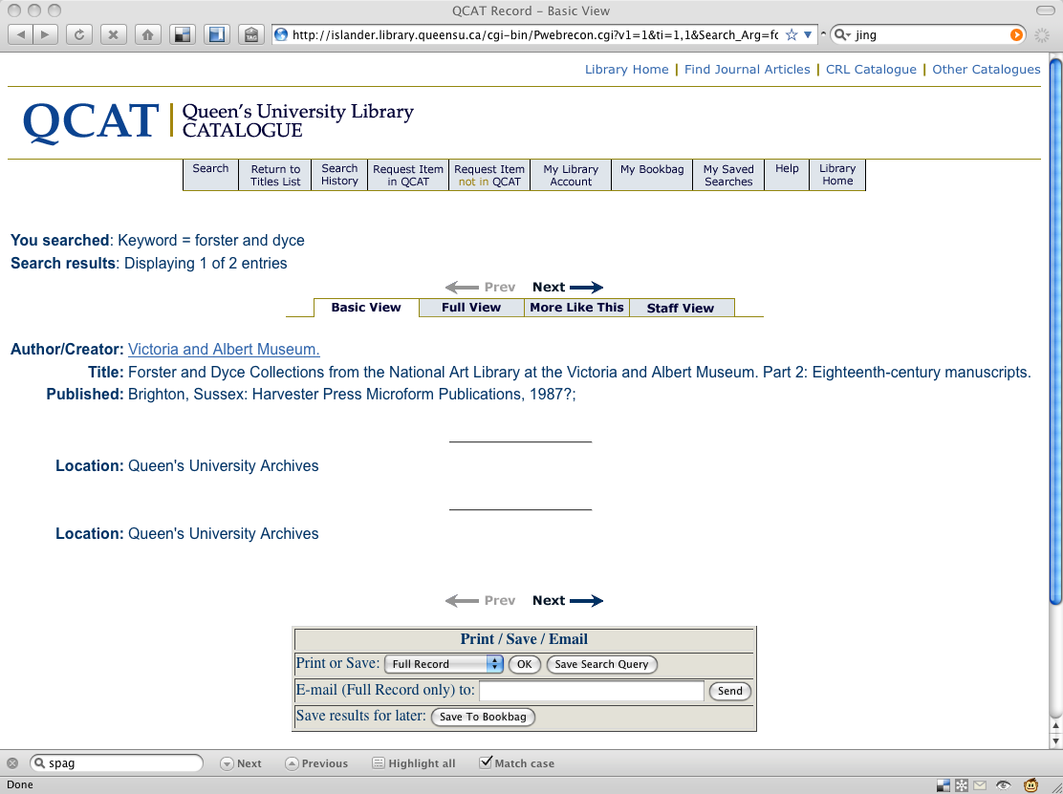
Eighteenth-Century Manuscripts: Samuel Richardson & Jonathan Swift are included in Part Two.
Correspondence of Defoe, Fielding, Inchbald, Burns, Burke, Cowper, Walpole and Hume. Some early letters of William Wordsworth date from 1797.
Inquire at the Archives
Notes:
Admittedly I don’t know what you can find in Archives. I have looked at the catalogue, but suspect I am not getting a full sense of holdings. I do know from conversations with Heather Home that there are letters of TS Eliot and other significant authors, beyond those with connection to Queen’s or Canada.

Slide 12
Multimedia Collections
Streaming Video
DVD Collection

Slide 13
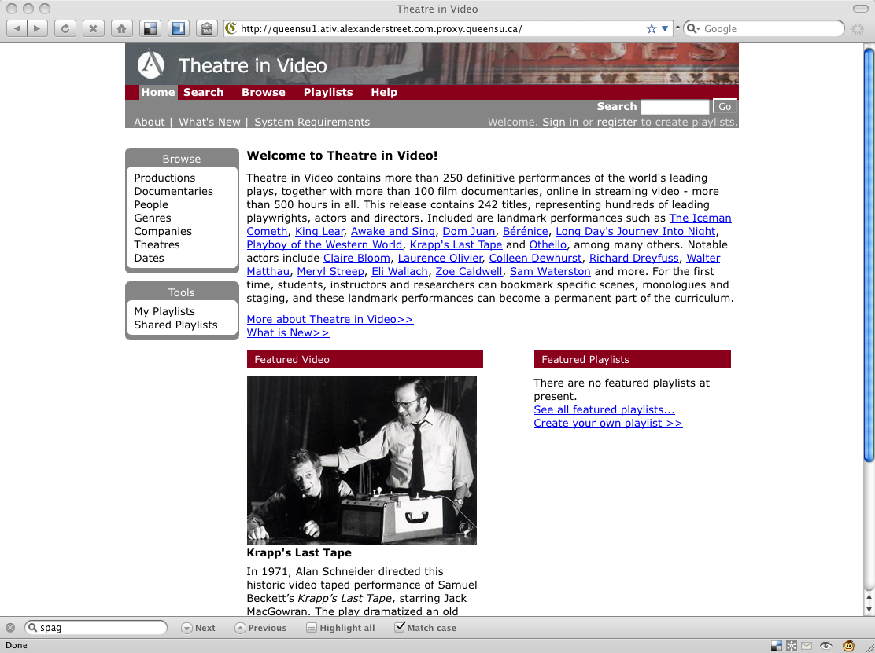
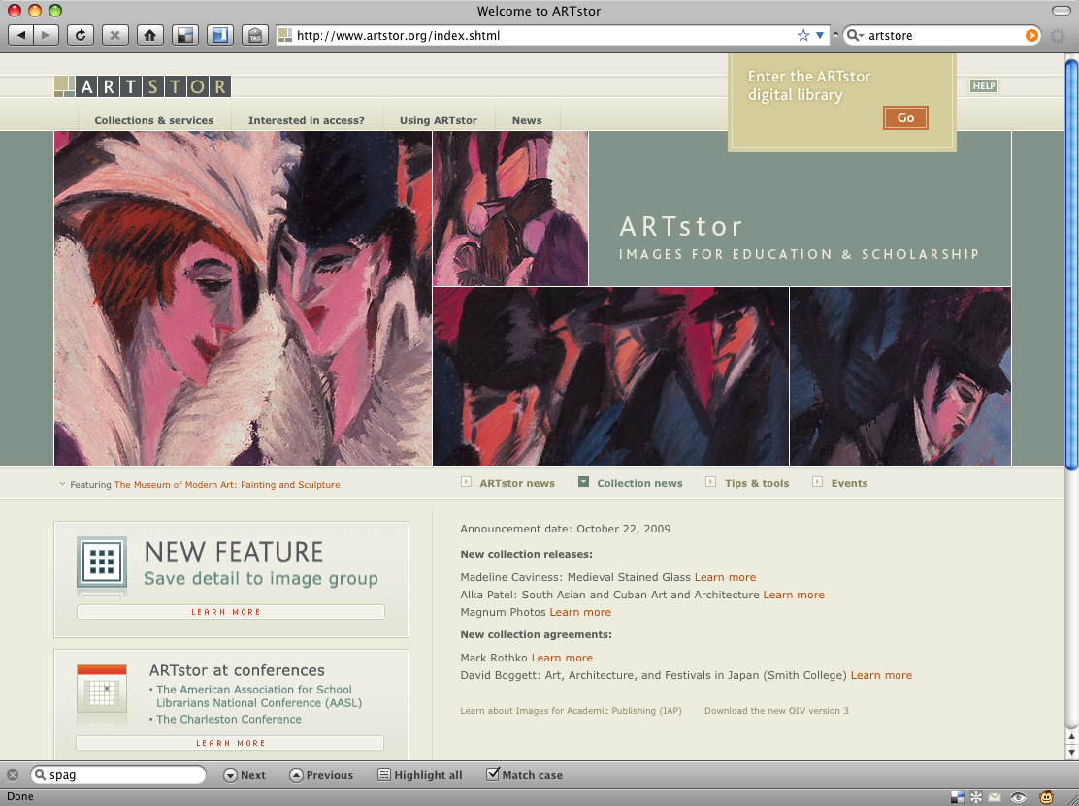
Multimedia Collections
Theatre in Video
http://queensu1.ativ.alexanderstreet.com.proxy.queensu.ca/
ArtStor
http://www.artstor.org.proxy.queensu.ca/index.shtml
Notes:
Theatre in Video – beckett, Ancient theatre, documentaries
ArtSTOR – Aubrey Beardsley
John William Waterhouse,
William Morris
Edward Burne-Jones,

Slide 14
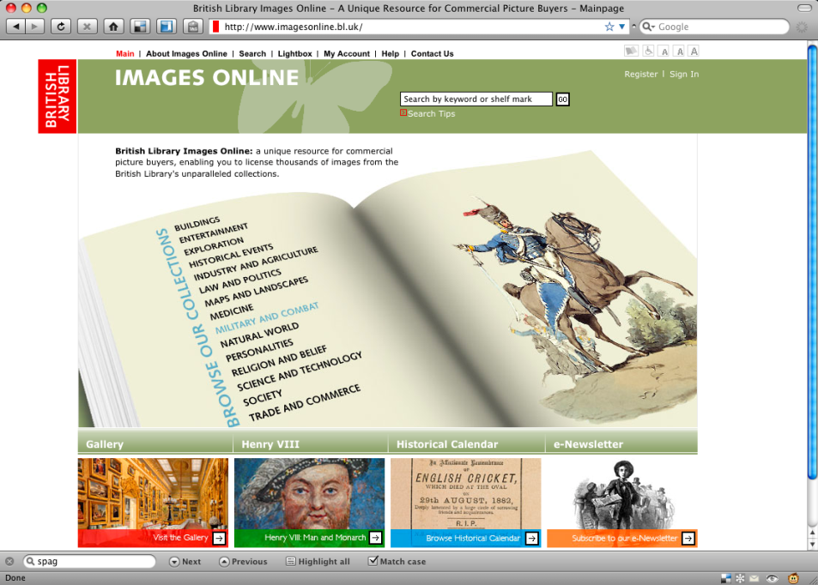
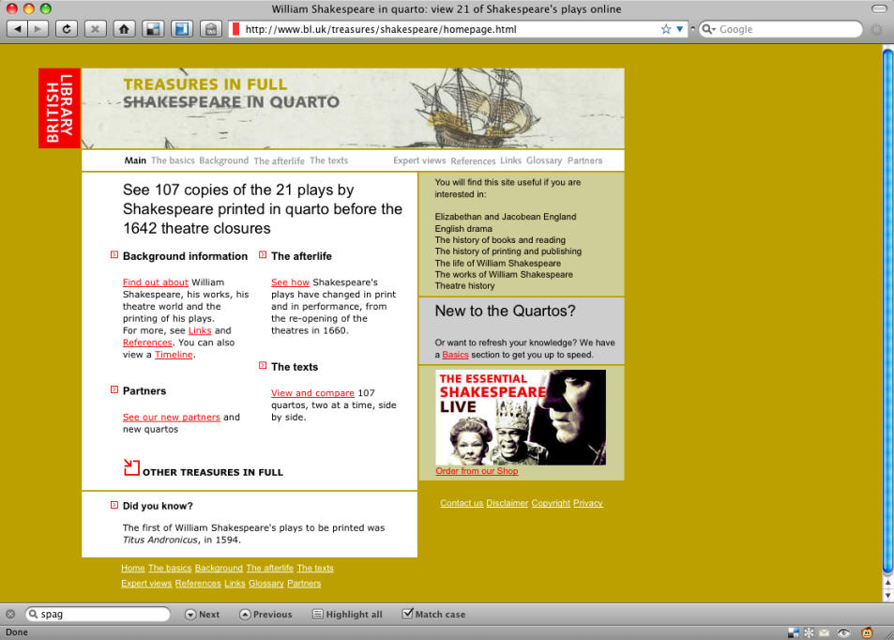
Multimedia Collections
British Library Images Online
http://www.imagesonline.bl.uk/
Shakespeare in quarto
http://www.bl.uk/treasures/shakespeare/homepage.html
Notes:
Smithsonian Global Sound for Libraries :http://external.queensu2.classical.com/

Slide 15
Calendar of Literary Facts
October 27...
1914: Dylan Thomas is born
1932: Sylvia Plath is born
1940: Maxine Hong Kingston is born
Contact: mcv@queensu.ca
Notes:
http://lion.chadwyck.com/poets_on_screen/vidlib_poets.jsp

